Slide 1


LEARNING
Miss Aisha Bano
aisha.bano@nu.edu.pk

Slide 2
What is Learning?
Learning is any relatively durable change in behavior or knowledge that is due to experience (Weiten, 2017).
Psychologists often define learning as a relatively permanent change in behavior brought about by experience. (Feldman, 2019).

Slide 3
Types of Learning
1) Trial & Error Learning (Thorndike)
2) Insight Learning (Wolfgang Kohler)
3) Learning by Imitation or observational learning
(Albert Bandura)
4) Cognitive Learning (E.C. Tolman)
5) Conditioning
Classical Conditioning (Ivan Pavlov)
Operant Conditioning (B.F. Skinner)

Slide 4
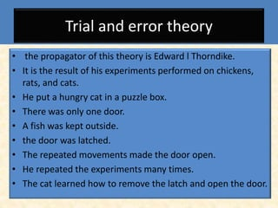
1. Learning by Trial & Error
(Thorndike)

Slide 5
2. Insight Learning
(Wolfgang Kohler)
A cognitive form of learning involving the mental rearrangement or restructuring of the elements in a problem to achieve a sudden understanding of the problem and arrive at a solution. Insight learning was described by Wolfgang Köhler in the 1920s, based on his observations of apes stacking boxes or using sticks to retrieve food, and was offered as an alternative to trial-and-error learning. (APA Dictionary)

Slide 6
3. Observational Learning
(Albert Bandura)
1. The acquisition of information, skills, or behavior through watching the performance of others, either directly or via such media as films and videos. Also called vicarious learning. (APA Dictionary)
2. Observational learning is the process of learning by watching the behaviors of others. The targeted behavior is watched, memorized, and then mimicked. Also known as shaping and modeling, observational learning is most common in children as they imitate behaviors of adults.

Slide 7
4. Cognitive Learning
(E.C.Tolman)
Cognitive learning is a change in knowledge attributable to experience (Myers, 2011).
This theory is about cognitive abilities like memory systems (code, store, recall and decode)
A Cognitive Map is any visual representation of a person’s (or a group’s) mental model for a given process or concept.
The influential cognitive map theory proposes that memories of recently travelled routes are combined with memories of previously travelled routes to create an integrated map of the environment.

Slide 8
5. Conditioning
Conditioning involves learning associations between events that occurs in an organism’s environment. (Weiten, 2017)
It is divided into following types:
Classical Conditioning (Ivan Pavlov)
Operant Conditioning (B.F. Skinner)

Slide 9
Types of Conditioning (defined)
1. Classical conditioning suggests that learning occurs when an association is formed between a previously neutral stimulus and a naturally occurring stimulus.
2. Operant conditioning is a type of associative learning that involves strengthening or weakening a behavior by using reinforcement or punishment.

Slide 10
Type 1. Classical Conditioning
(Ivan Pavlov)
The classical conditioning process involves pairing a previously neutral stimulus (such as the sound of a bell) with an unconditioned stimulus (the taste of food). This unconditioned stimulus naturally and automatically triggers salivating as a response to the food, which is known as the unconditioned response.

Slide 11
Terms associated with learning:
Stimulus: Energy that produces a response in a sense organ.
Response: Any behavior of an organism that can be identified and measured.
Conditioning: The process of evoking a specific response other than natural response by presenting a particular stimulus.

Slide 12
terms continued…
Unconditioned Stimulus: A stimulus that causes an automatic response
Unconditioned Response: Automatic reaction (not learned)
Conditioned Stimulus: A learned stimulus
Conditioned Response: A learned response

Slide 13
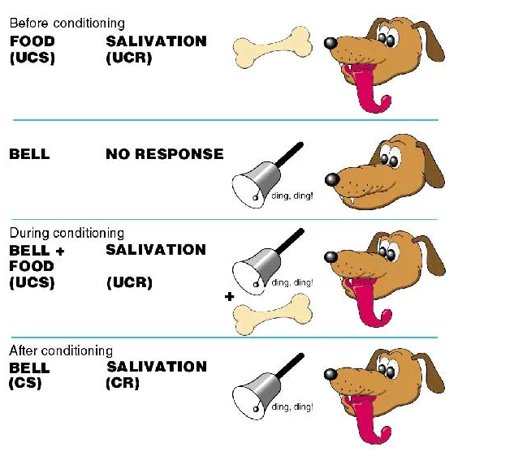
Process of Classical Conditioning

Slide 14
Basic Principles in Classical Conditioning
1. Acquisition : Forming New Responses
It refers to the initial stage of learning a new response tendency.
2. Extinction: Weakening Conditioned Responses
When a conditioned stimulus eventually losses its ability to bring about a conditioned response.
  Experimenter kept ringing bell and eventually the dog no longer salivated to the bell only.
3. Spontaneous Recovery
When a conditioned response occurs after extinction.
  Extinction had occurred, a day or two had passed during which the dogs did not hear the bell at all. After this rest period, the bell was rung and caused salivation (not as much saliva produced, but some)

Slide 15
Principles continued…
4. Generalization
Act of responding in the same ways to stimuli that seem to be similar, even if the stimuli are not identical.
  Example: My dad used to call us home with a whistle. One day another dad whistled, however, I thought it was mine and went home.
5. Discrimination
Responding differently to stimuli that are not similar to each other.
  Example: Response to fire bell is different to your response to the bell that changes classes.

Slide 16
Type 2: Operant Conditioning
(B.F. Skinner)
Operant Conditioning: Learning in which a voluntary response is strengthened or weakened, depending on its favorable or unfavorable consequences (Feldman,2011).
B.F. Skinner focused on the role of Reinforcement.
Reinforcement: The process by which a stimulus increases the probability that a preceding behavior will be repeated (Feldman, 2011).

Slide 17
Reward/ Reinforcer: A stimulus that increases the frequency of a behavior.
  can be used interchangeably with the term positive reinforcement.
  generally the shorter the time in receiving the reward after a correct response, the more likely it is that an organism will learn that response.
Punishment: A stimulus that decreases the probability that a previous behavior will occur again.
Example: To clean the house to get rid of the physical abuse by parents.

Slide 18
Reinforcement
Positive
Negative
Positive reinforcement occurs when a response is strengthened because it is followed by the presentation of a rewarding stimulus (Weiten, 2017).
Examples
Good grades, tasty meals, paychecks, scholarships, promotions, nice clothes, nifty cars, attention, and flattery all are positive reinforcers.
Negative reinforcement occurs when a response is strengthened because it is followed by the removal of an aversive (unpleasant) stimulus (Weiten, 2017)..
Examples
To clean the house to get rid of a mess around.
One gives in to a roommate or spouse to bring an unpleasant argument to an end.

Slide 19
Schedules of Reinforcement:
Two types of schedules:
  Continuous:
    Reinforcement of a behavior every time the behavior occurs…since this is not practical…a lot of times the behavior is short lived and will disappear very quickly if the reinforcement stops for any period of time (example: rewarding kindergarten student a star(s) on hand/face, emoticon of smiley in marking)
  Partial or Intermittent:
    Behavior is not reinforced every time the behavior occurs, instead, it is given intermittently…the behavior learned through this type of reinforcement tends to last longer after the reinforcement ends (example: marks in mid-1, mid-2, & final exams)

Slide 20
Principles of Operant Conditioning
  1. Acquisition and 2. Shaping
As in classical conditioning, acquisition in operant conditioning is the formation of a new response tendency.
Operant responses are typically established through a gradual process called shaping: A technique used to teach complex behaviors by reinforcing small steps in the right direction.

Slide 21
Principles of Operant Conditioning
3. Extinction
In operant conditioning, extinction refers to the gradual weakening and disappearance of a response tendency because the response is no longer followed by reinforcement.
Example: Experiment of Rat in Skinner box will eventually stop pressing the bar if no reinforcement (food) is given.
4. Generalization
Response increases in the presence of new stimulus that resembles the original (discriminative) stimulus
5. Discrimination
Response does Not increase in the presence of new stimulus that resembles the original (discriminative) stimulus

Slide 22
Factors influencing Learning
Motivation:
Interest
Reward and punishment
Group participation
Familiarity
Meaningfulness

